Slide 1
Spring bean inheritance
In java, we have already seen the benefit of inheritance which is Reusability.
That is, if we have some properties in the base class then child class will inherit those properties and its values.
We can also override those values in the Child class.
Similarly in Spring, we can inherit the beans properties and its values and we can also override them.

Slide 2

Spring bean inheritance

Slide 3
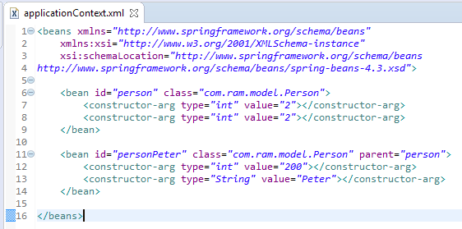
Spring bean inheritance
By using the parent attribute of bean, we can specify the inheritance relation between the beans. In such case, parent bean values will be inherited to the current bean.

Slide 4
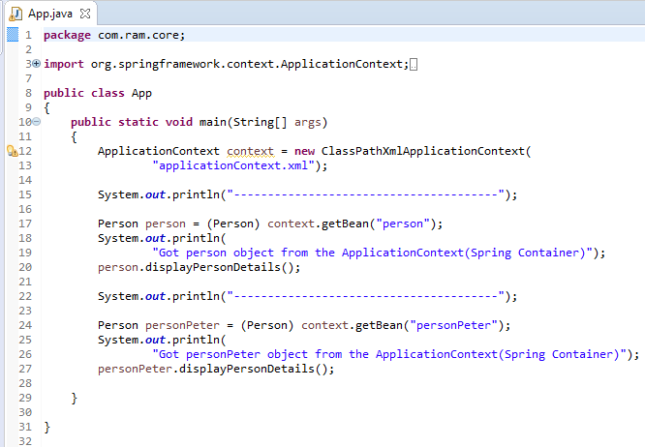
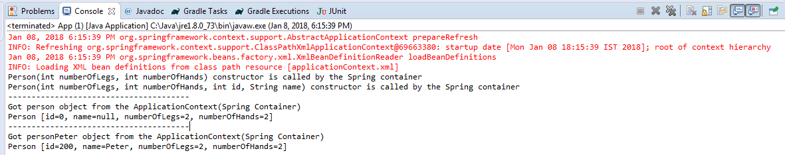
Spring bean inheritance

